Slide 1

Vibe coding and working with Gen-AI APIs
Omar Abdallah
ommohamed@iti.gov.eg
Hany Saad
hghiett@iti.gov.eg

Slide 2
AI-Powered Coding Assistant Tools
Course Title: AI-Powered Coding Assistant Tools
Duration: 12 Hours ( Lecture + Lab )
Evaluation: Attendance + Task
Prerequisites:
Intro to Generative AI and Prompt Engineering
Core Programming Courses

Slide 3
AI-Powered Coding Assistant Tools
Outlines:
Intro to AI-powered Coding Assistant tools
Benefits, limitations and security considerations.
Exploring GitHub Copilot features:
Code auto-completion, Copilot Chat, , Multi-file edits, Copilot Workspace.
Overview on another alternatives:
Cursor, TabNine, …
Implementing full feature on existing App using GitHub Copilot software agents.

Slide 4
Why do we need to know about Gen-AI?

Slide 5
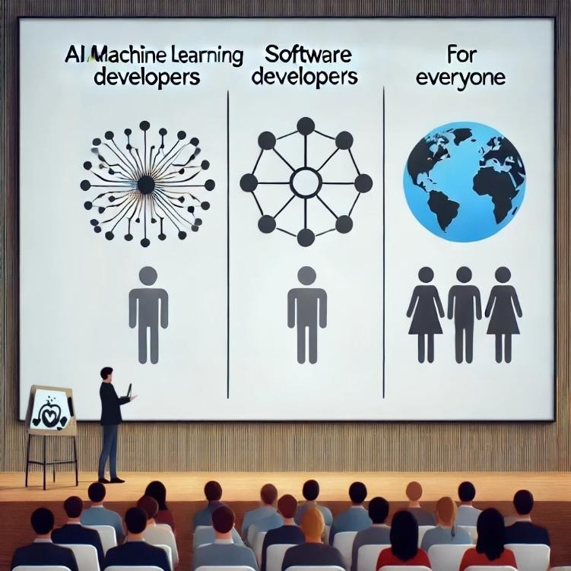
Why should we learn about Gen AI?
AI / Machine Learning Developers:
Design and refine Generative AI models to create more intelligent and efficient AI-driven solutions.
Software Developers:
Utilize AI tools to enhance productivity in development tasks.
Leverage Generative AI APIs to build AI-powered applications
Everyone:
In today’s AI-centric world, it’s crucial for individuals across all professions to grasp the basics of Generative AI and incorporate AI tools into their workflows to boost productivity.

Slide 6

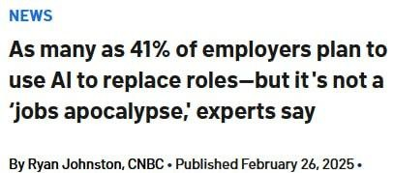
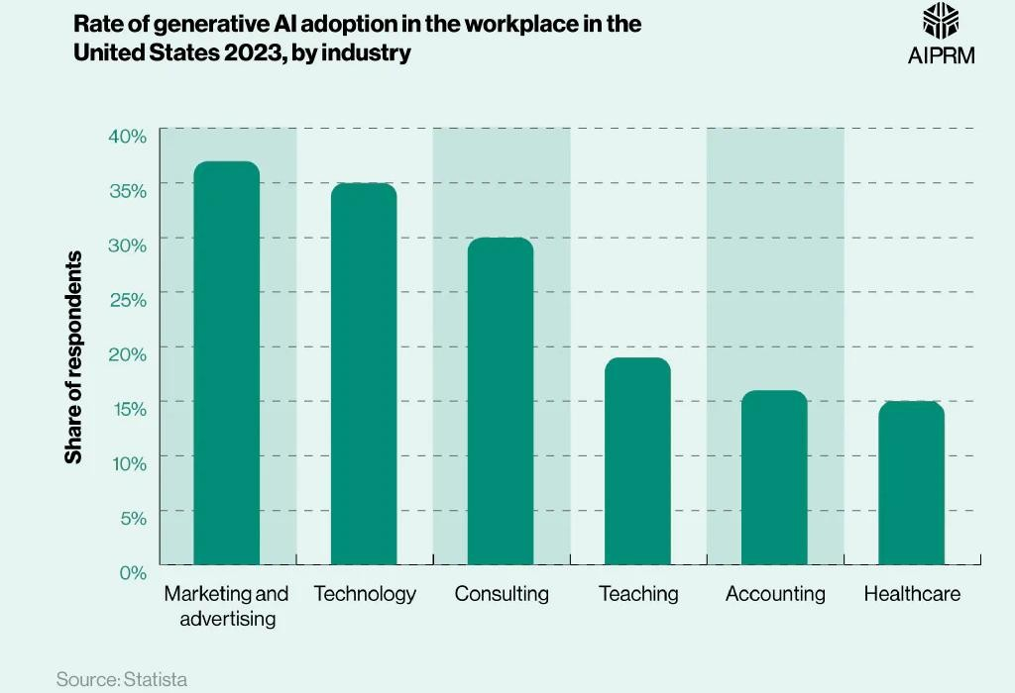
Why should we learn about Gen AI?
Will AI replace jobs / employees ?

Slide 7
Gen-AI based startups and real products
Use cases for real products using Gen AI:
Loop-x (AI Agents for different roles): https://loop-x.co
Gemelo ai (Twin AI creator): https://gemelo.ai
Apriora AI (Recruitment and Interviews): https://www.apriora.ai
Velents AI (Recruitment and Interviews): https://www.velents.com
Nancy AI (Recruitment and Interviews): https://nancy-ai.com
Mariana AI (Medical): https://marianaai.com

Slide 8
How to use the AI tools responsibility?
As a Student / Learner:
Use AI for asking for explanation, self—testing, researching, and similar activities.
Don’t Use AI for assignments, projects, or inside topics you’re still learning.
Build Your Skills to work effectively both with AI and without AI.
In a Job or Freelancing :
Check First if AI tool usage is permitted and which tools are allowed.
Use AI to boost productivity and improve your work
Always review AI-generated content carefully
Don’t rely on AI for tasks you have no prior knowledge of.

Slide 9
“You write one line — AI writes five back. You ask a question — it answers with context. That’s the vibe.”

Slide 10
AI Tools For Developers

Slide 11
AI-Powered Coding Assistant Tools
What is an AI Coding Assistant Tool?
AI Coding Assistant tools are software tools or IDE extensions that leverage artificial intelligence to assist developers in writing, understanding, and improving the code.
Key Capabilities:
Code Suggestions and Auto-completion: Offers real-time suggestions for completing code blocks, reducing manual typing.
Error Detection and Fixes: Identifies potential errors or bugs and suggests solutions or fixes automatically.
Code Generation: Can generate entire code snippets or functions based on prompts or comments.
Code Refactoring: Helps improve the structure of existing code for better performance or readability.
Documentation Support: Generates or improves comments and documentation based on the code context.

Slide 12
AI-Powered Coding Assistant Tools
Top AI Coding Assistant Tools:
GitHub Copilot
Gemini Code Assistant
Cursor AI
Replit Ghostwriter
Codium AI
TabNine
… and more

Slide 13
What’s GitHub Copilot
GitHub Copilot is a cloud-based AI pair programming tool developed by GitHub and Open AI based on OpenAI codex model to autocomplete and suggest code and entire functions for faster development, It could also generate code from scratch from a well documented code comments.
GitHub Copilot integrates directly into your editor including Neovim, JetBrains IDEs, Visual Studio, and Visual Studio Code.
GitHub Copilot provides suggestions for numerous languages and a wide variety of frameworks, but works especially well for Python, JavaScript, TypeScript, Ruby, Go, C#, and C++.
GitHub Copilot History:
On June 29, 2021, GitHub announced GitHub Copilot for technical preview in the Visual Studio Code development environment. GitHub announced Copilot's availability for the Visual Studio 2022 IDE on March 29, 2022. On June 21, 2022, GitHub announced that Copilot was out of "technical preview" and is available as a subscription-based service for individual developers.

Slide 14
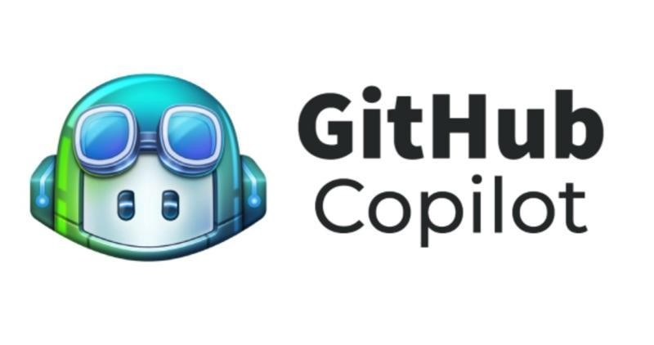
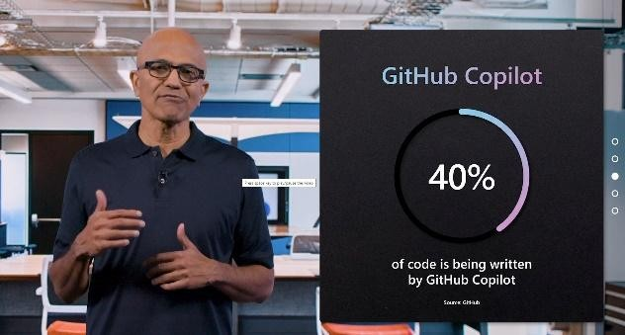
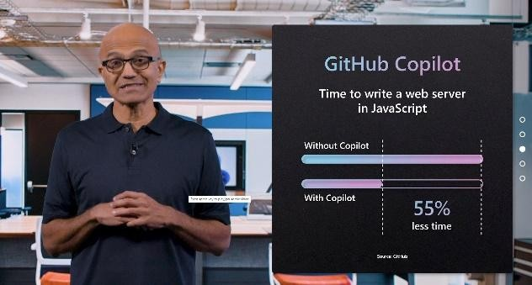
What’s GitHub Copilot
GitHub Copilot is a cloud-based AI pair programming tool developed by GitHub and Open AI based on OpenAI codex model to autocomplete and suggest code and entire functions for faster development, It could also generate code from scratch from a well documented code comments.
GitHub Copilot integrates directly into your editor including Neovim, JetBrains IDEs, Visual Studio, and Visual Studio Code.
GitHub Copilot provides suggestions for numerous languages and a wide variety of frameworks, but works especially well for Python, JavaScript, TypeScript, Ruby, Go, C#, and C++.
GitHub Copilot History:
On June 29, 2021, GitHub announced GitHub Copilot for technical preview in the Visual Studio Code development environment. GitHub announced Copilot's availability for the Visual Studio 2022 IDE on March 29, 2022. On June 21, 2022, GitHub announced that Copilot was out of "technical preview" and is available as a subscription-based service for individual developers.

Slide 15
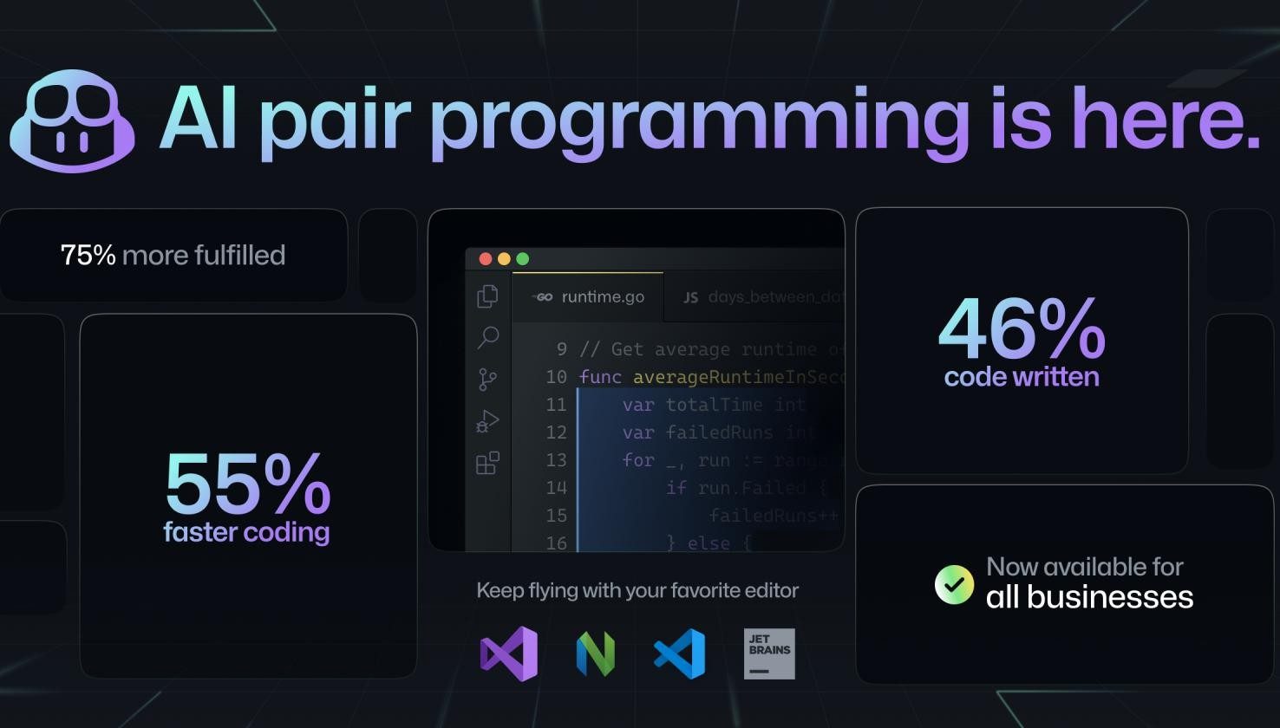
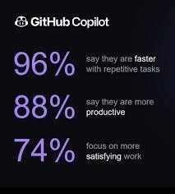
What’s GitHub Copilot

Slide 16
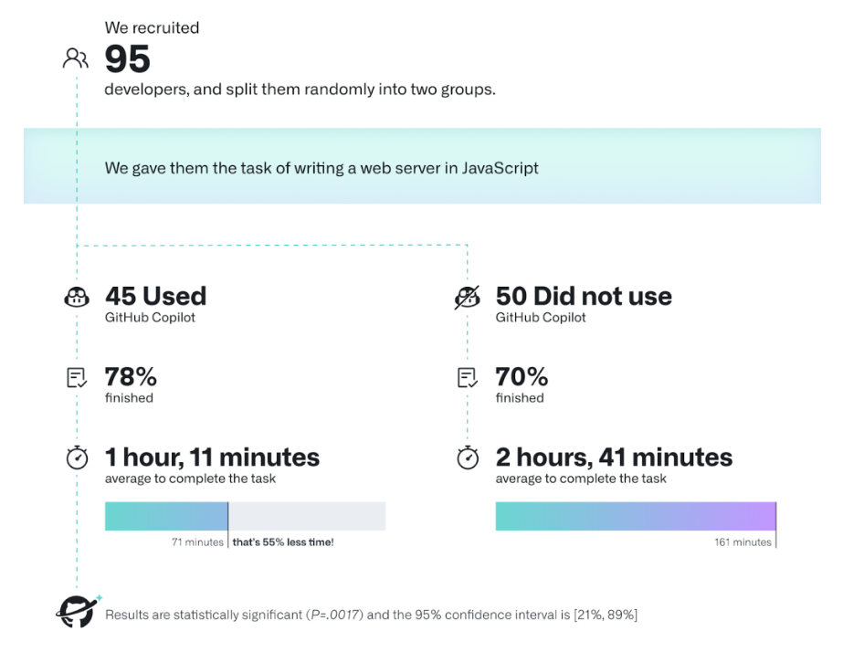
What’s GitHub Copilot

Slide 17
GitHub Copilot Use Cases
Code generation and suggestions
Unit test generation
Code reviews and refactoring
Bug fixing
Generating code documentation and explaining code
Generating SQL queries
GitHub Copilot Chat
Cloud deployment guidance and troubleshooting (e.g., Azure, AWS)
Automating CI/CD pipeline tasks
Optimizing code performance
Command-line tool assistance
Pull request summaries
Managing and interacting with cloud resources (e.g., Azure services)
Translating code between programming languages
Enhancing security by identifying vulnerabilities
Auto-generating comments and annotations
Writing configuration files (e.g., YAML, JSON, Dockerfiles)
Automating repetitive tasks (e.g., regex creation, cron jobs)
Real-time feedback on coding best practices
Knowledge base querying for organization-specific documentation

Slide 18
GitHub Copilot Features
Code Completion: GitHub Copilot provides context-aware, autocomplete-style code suggestions in popular IDEs such as Visual Studio Code, Visual Studio, JetBrains IDEs, Azure Data Studio, and Vim/Neovim.
Copilot Chat: This feature allows you to interact with Copilot via a chat interface. It is available in supported IDEs (Visual Studio Code, Visual Studio, and JetBrains IDEs), on GitHub.com, and in GitHub Mobile. It supports natural language queries for code explanations, debugging help, translating between programming languages, and more. Copilot Chat is powered by GPT-4 and can assist with context-specific coding scenarios​.
Copilot for the Command Line (CLI): This feature extends Copilot's assistance to the terminal. You can use commands like gh copilot suggest to get command recommendations or gh copilot explain to get explanations of commands. This feature also supports creating command aliases and executing suggested commands directly from the terminal.
GitHub Copilot Extensions (Beta): provide developers with enhanced AI-assisted capabilities tailored to specific workflows or environments. These extensions integrate directly into popular development platforms and tools, offering greater flexibility and customization for coding tasks

Slide 19
GitHub Copilot Features (Cont.)
GitHub Copilot for Azure (Beta): is a specialized extension that integrates GitHub Copilot's AI-powered coding assistance with Azure services. It acts as a cloud coding companion that helps developers interact with Azure resources directly from their IDE, enhancing productivity and reducing the complexity of cloud development.
Copilot in GitHub.com: Integrates directly into the platform for users subscribed to Copilot Individual or Business plans. This allows developers to harness AI directly in their browser without needing to switch to an IDE.
Pull Requests Summaries: (Enterprise Only): Copilot can automatically generate summaries of pull requests, highlighting changes, their impact on files, and areas of interest for reviewers. This feature saves time during code reviews​.
GitHub Copilot workspace: development environment that helps developers plan, write, and test code using natural language. It supports multi-file changes, integrates with GitHub Code spaces, and allows real-time editing and debugging for seamless collaboration.
Text Completion (Enterprise Only): Copilot also assists with natural language tasks, such as generating text descriptions for pull requests and other documentation​.
Knowledge Bases (Enterprise Only): This feature allows users to create collections of documentation that can be used as a reference for Copilot Chat, enabling more informed answers​.

Slide 20
GitHub Copilot Features (Cont.)
Slash Commands
Take advantage of Copilot's slash commands such as /fix, /explain, /doc, and /tests for common development tasks.
These commands allow you to quickly fix code, generate explanations, create documentation, and write unit tests.
Examples:
/fix: Proposes a fix for selected code.
/explain: Provides a detailed explanation of the selected code.
/doc: Generates documentation for the code.
/tests: Creates unit tests for the selected code.
Chat Participants (@ Operator)
Use @workspace to instruct Copilot to consider your entire project when responding. This ensures Copilot.
Leverages all open files and configurations in the workspace.
Other participants like @terminal help Copilot assist with terminal-related tasks, including shell commands.

Slide 21
GitHub Copilot Features (Cont.)
File and Section References (# Operator)
Reference specific files, classes, or methods using the #file or #method syntax. This helps Copilot focus on particular sections of your code and improves accuracy.
Examples:
#BasketService.cs: Points Copilot to a specific file..
#AddItemToBasket: Directs Copilot to a particular method.
Inline chat
Press CMD+I (or CTRL+I on Windows) to bring up inline chat directly within your code.
Ask questions, get explanations, or generate code snippets without leaving your current workflow. Inline chat provides context-aware suggestions based on the code you're working on.

Slide 22
Working with Gen-AI APIs

Slide 23

Working with Gen AI APIs
OpenAI Models
DeepSeek AO Models
Google AI Models
Anthropic AI Models
Qwen AI Models
MS Azure OpenAI Service
Hugging Face Platform
MS Azure AI Models
GitHub Models

Slide 24
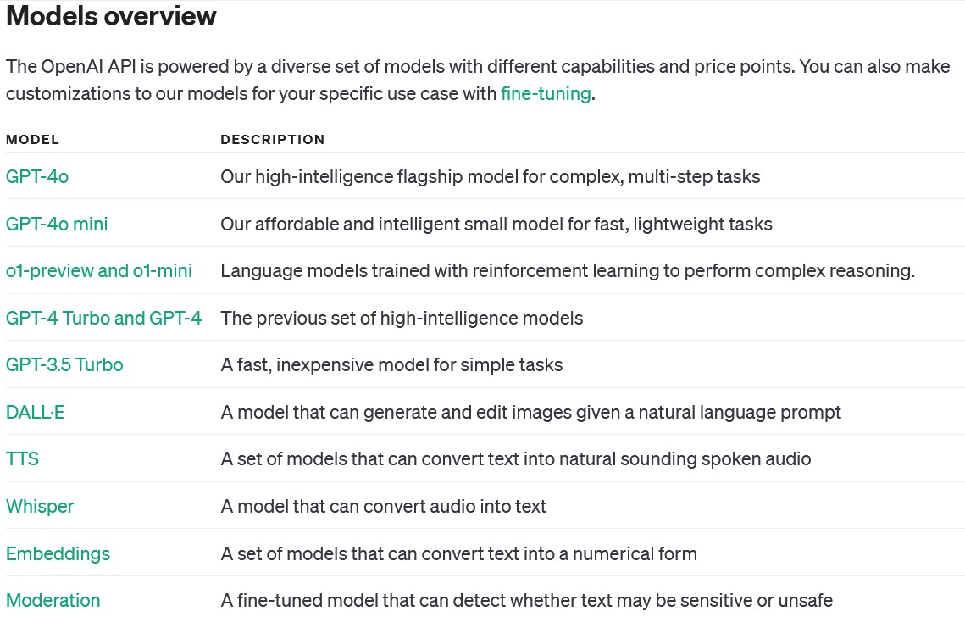
Models and Capabilities
OpenAI
Models
https://platform.openai.com/docs/models

Slide 25
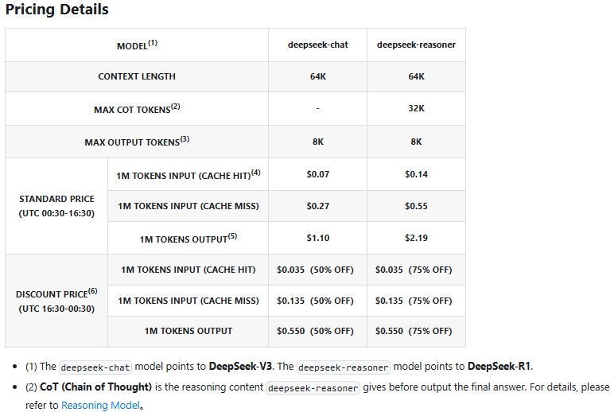
Models and Capabilities
DeepSeek
AI Models
https://apidocs.deepseek.com/quick_start/pri cing

Slide 26
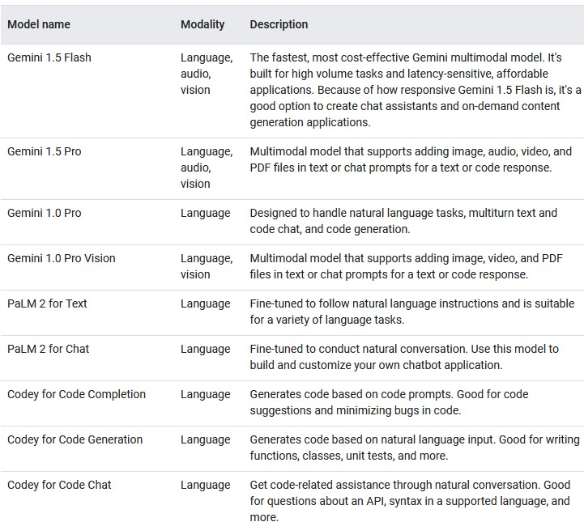
Models and Capabilities
Google AI
Models
https://deepmind.google/models/

Slide 27
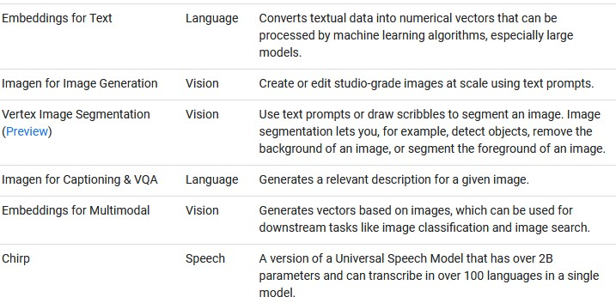
Models and Capabilities
Google AI
Models
https://deepmind.google/models/

Slide 28
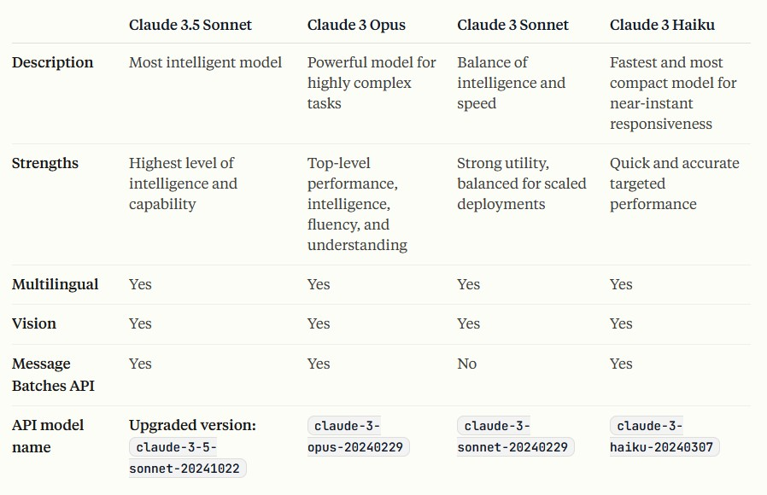
Models and Capabilities
Anthropic
AI Models
https://docs.anthropic.com/en/docs/about-claude/models/overview

Slide 29
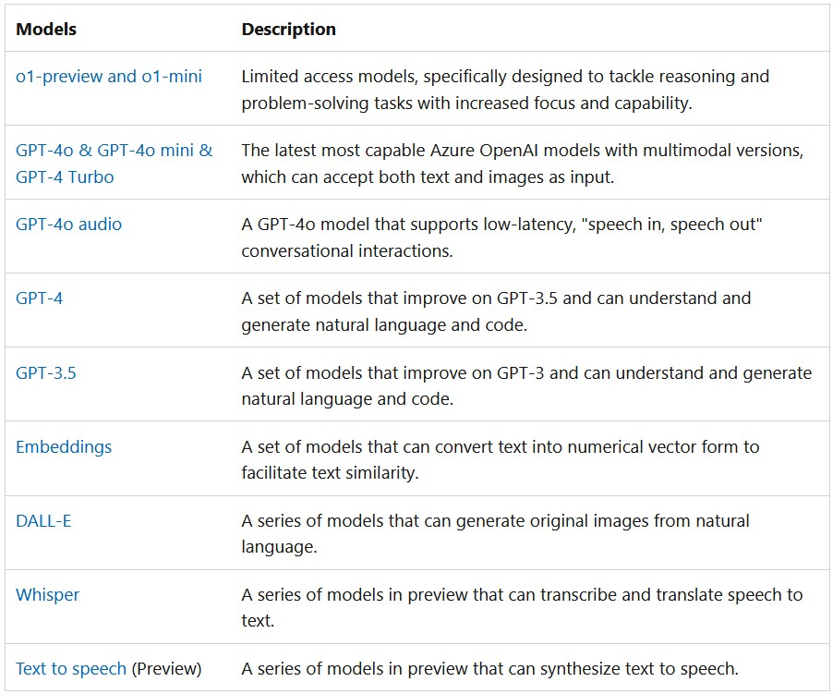
Models and Capabilities
MS Azure
OpenAI
Service
https://azure.microsoft.com/en-us/products/ai-services/openai-service

Slide 30
Open Source Models

Slide 31
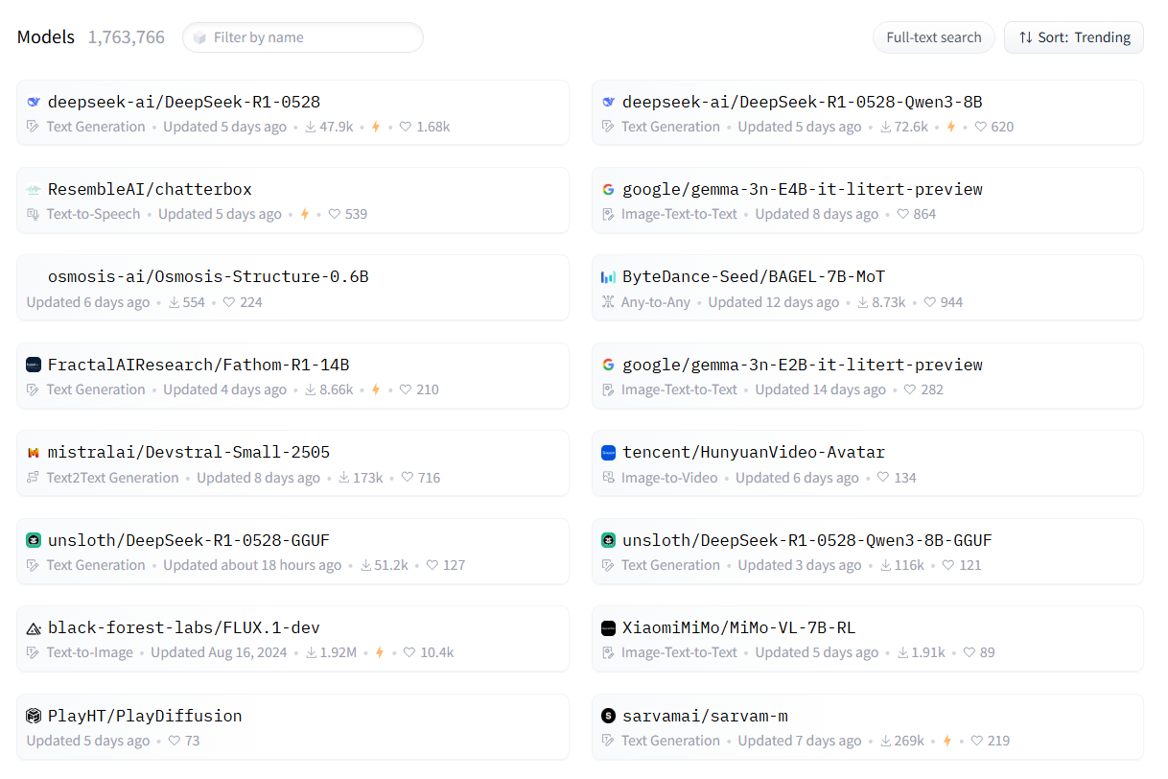
Models and Capabilities
Hugging
Face
Models
https://huggingface.co/models

Slide 32
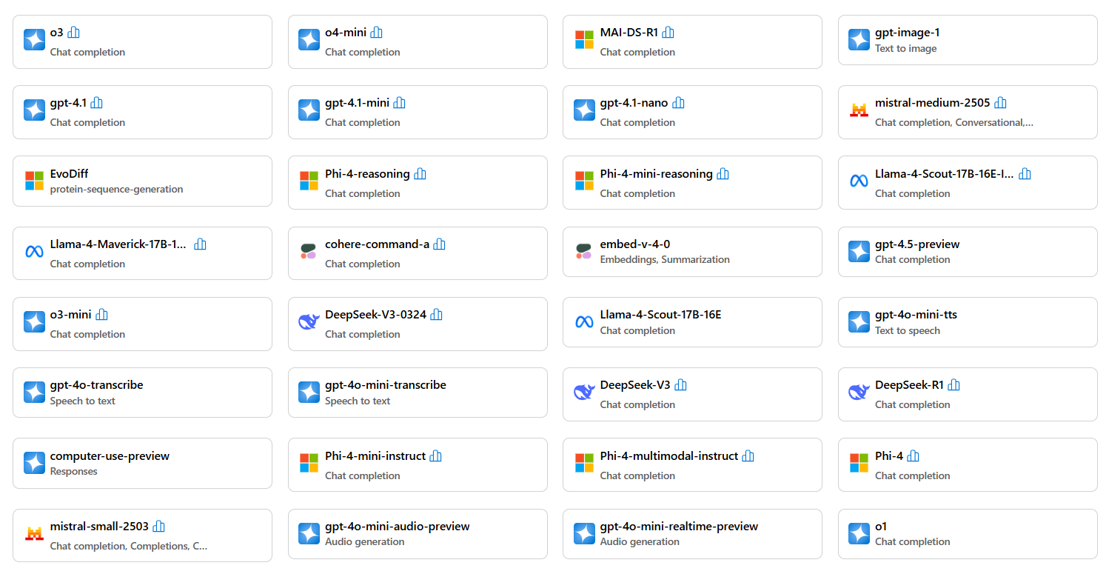
Models and Capabilities
MS Azure
AI Models
https://ai.azure.com/explore/models

Slide 33
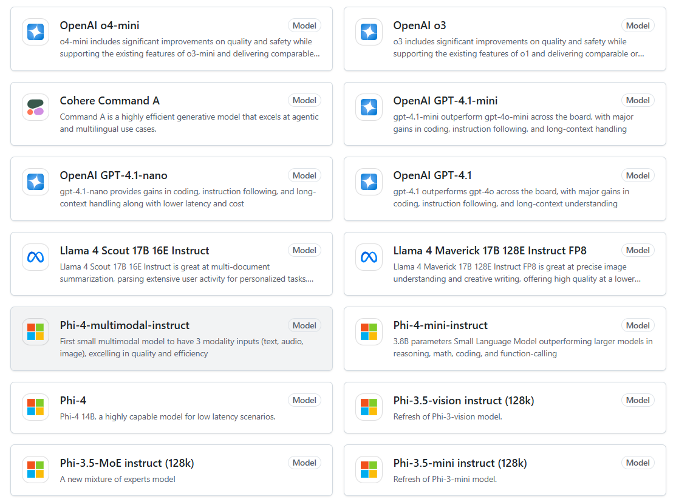
Models and Capabilities
GitHub
AI Models
https://github.com/marketplace/models

Slide 34
OpenAI APIs

Slide 35
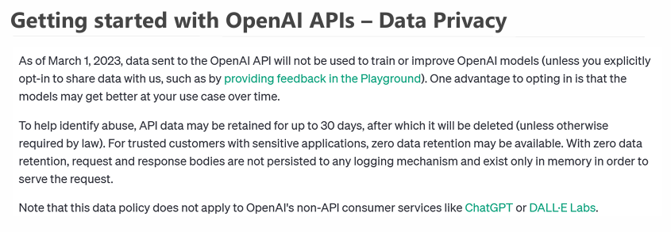
OpenAI APIs

Slide 36
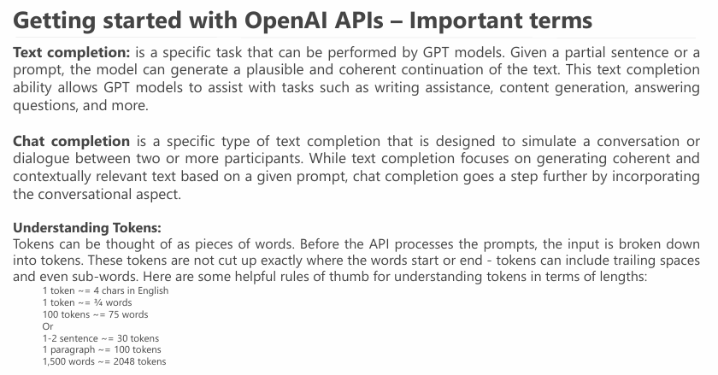
OpenAI APIs

Slide 37
OpenAI APIs
Getting started:
First, you need to create an OpenAI account.
Go to OpenAI platform
Create API_Key from here
Finally, you can access the APIs as REST APIs from here, or you can use provided libraries for different languages here
Documentation and pricing:
OpenAI API models pricing.
OpenAI APIs Docs.
API Reference
OpenAI Examples.
OpenAI Cookbook
How to work with APIs
Using Language specific SDK
Using REST API

Slide 38
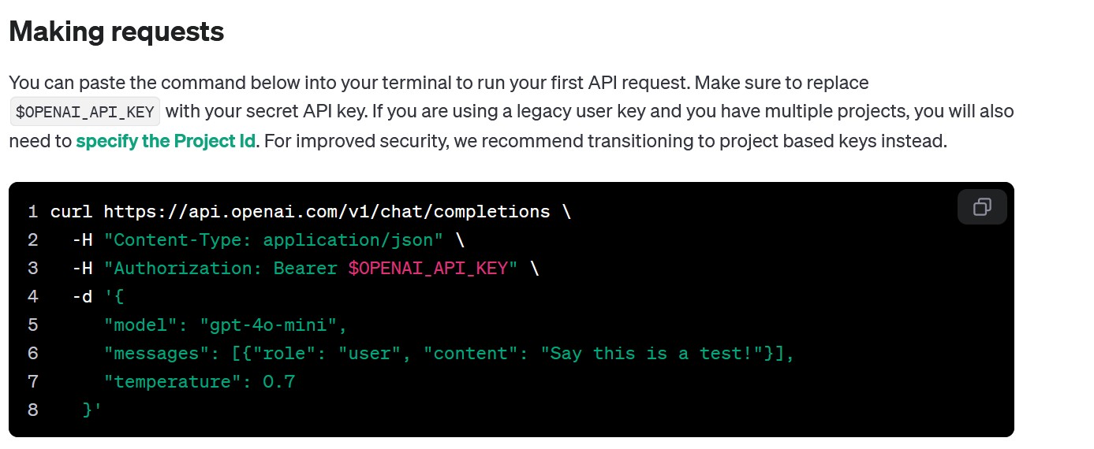
OpenAI APIs
https://platform.openai.com/docs/api-reference/chat/create

Slide 39
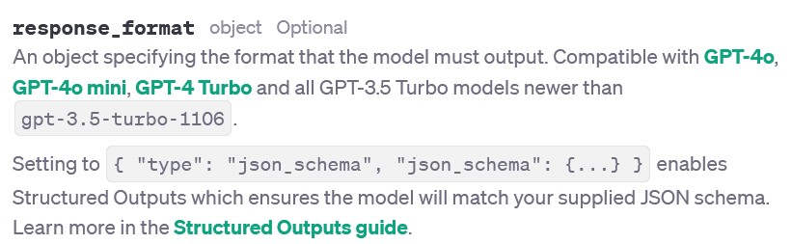
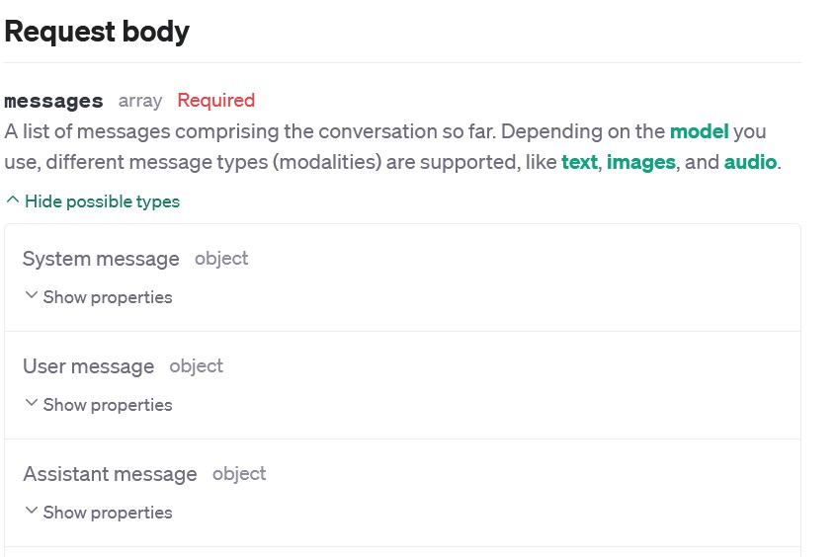
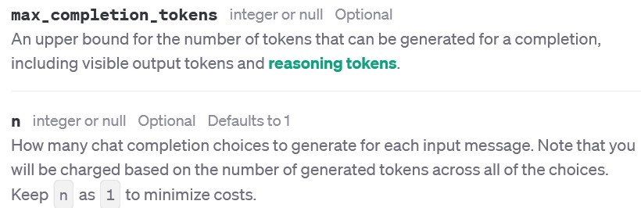
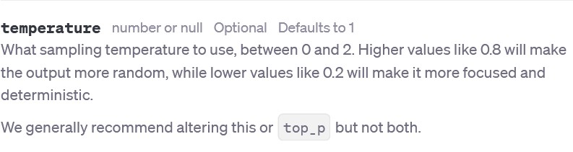
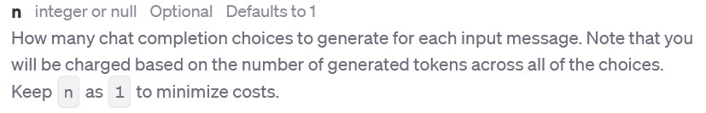
OpenAI APIs

Slide 40
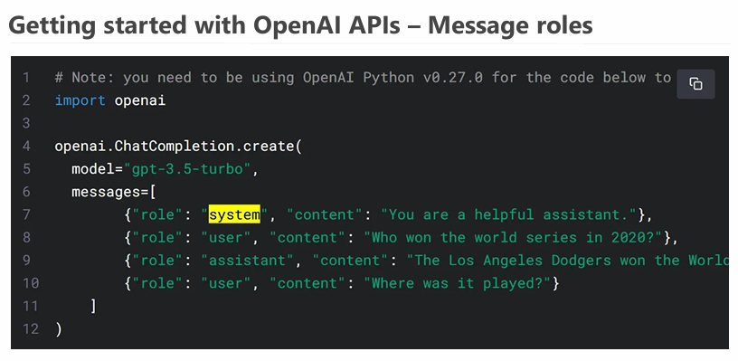
OpenAI APIs

Slide 41
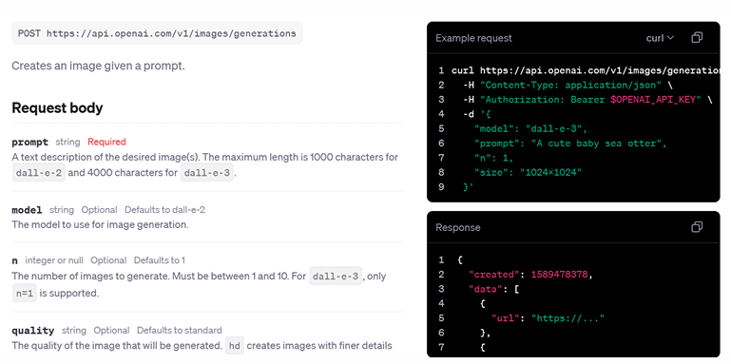
OpenAI APIs
OpenAI APIs – Image generation (API Reference)

Slide 42
Online courses resources
Different learning paths

Slide 43
Resources (DeepLearning.ai – Free)
Python intro (Optional):
AI Python for Beginners: https://www.deeplearning.ai/short-courses/ai-python-for-beginners/
Prompt engineering for Devs, OpenAI APIs
ChatGPT Prompt Engineering for Developers: https://www.deeplearning.ai/short-courses/chatgpt-prompt-engineering-for-developers/
Building Systems with the ChatGPT API: https://www.deeplearning.ai/short-courses/building-systems-with-chatgpt/
Reasoning with o1: https://www.deeplearning.ai/short-courses/reasoning-with-o1/
Open-Source models & Hugging-face:
Open-Source Models with Hugging Face: https://www.deeplearning.ai/short-courses/open-source-models-hugging-face/
Introducing Multimodal Llama 3.2: https://www.deeplearning.ai/short-courses/introducing-multimodal-llama-3-2/
Ollama – Run LLM Locally:
Learn Ollama in 15 Minutes - Run LLM Models Locally for FREE (YouTube): https://www.youtube.com/watch?v=UtSSMs6ObqY
Ollama Course – Build AI Apps Locally (YouTube – Intermediate - Optional): https://www.youtube.com/watch?v=GWB9ApTPTv4
LangChain, RAG, AI Agents:
LangChain for LLM Application Development: https://www.deeplearning.ai/short-courses/langchain-for-llm-application-development/
LangChain: Chat with Your Data: https://www.deeplearning.ai/short-courses/langchain-chat-with-your-data/
AI Agents in LangGraph (Intermediate): https://www.deeplearning.ai/short-courses/ai-agents-in-langgraph/
Functions, Tools and Agents with LangChain (Intermediate): https://www.deeplearning.ai/short-courses/functions-tools-agents-langchain/
AI Agent and multi-agent:
Multi AI Agent Systems with crewAI (Beginner): https://www.deeplearning.ai/short-courses/multi-ai-agent-systems-with-crewai/
AI Agentic Design Patterns with AutoGen (Beginner – Optional): https://www.deeplearning.ai/short-courses/ai-agentic-design-patterns-with-autogen/
RAG (Intermediate):
Building and Evaluating Advanced RAG Applications: https://www.deeplearning.ai/short-courses/building-evaluating-advanced-rag/
Building Multimodal Search and RAG: https://www.deeplearning.ai/short-courses/building-multimodal-search-and-rag/
RAG using LlamaIndexL (Optional):
Building Agentic RAG with LlamaIndex: https://www.deeplearning.ai/short-courses/building-agentic-rag-with-llamaindex/
JavaScript RAG Web Apps with LlamaIndex: https://www.deeplearning.ai/short-courses/javascript-rag-web-apps-with-llamaindex/
Other (Optional):
How Transformer LLMs Work: https://www.deeplearning.ai/short-courses/how-transformer-llms-work/
Generative AI for Software Development: https://www.deeplearning.ai/courses/generative-ai-for-software-development/

Slide 44
Resources (YouTube - Free)
YouTube Playlists (Free)
Generative AI in a Nutshell: https://www.youtube.com/watch?v=2IK3DFHRFfw-
Generative AI Tools (From Edureka): https://www.youtube.com/watch?v=gMa_QHSAxOY&list=PL9ooVrP1hQOFIOOkGN2gbjvse8jcz-mux
Introduction to Generative AI and LLMs (From Microsoft, covering intro RAG, Fine Tuning, and most dev topics): https://www.youtube.com/playlist?list=PLlrxD0HtieHj2nfK54c62lcs3-YSTx3Je
RAG:
Learn RAG From Scratch – Python AI Tutorial from a LangChain Engineer: https://www.youtube.com/watch?v=sVcwVQRHIc8
AI Agents:
How To Create Ai Agents From Scratch (CrewAI, Zapier, Cursor): https://www.youtube.com/watch?v=PM9zr7wgJX4
The Complete Guide to Building AI Agents for Beginners: https://www.youtube.com/watch?v=MOyl58VF2ak
Python Advanced AI Agent Tutorial - LlamaIndex, Ollama and Multi-LLM!: https://www.youtube.com/watch?v=JLmI0GJuGlY
ADVANCED Python AI Agent Tutorial - Using RAG: https://www.youtube.com/watch?v=ul0QsodYct4
GitHub Copilot for developers (From Microsoft): https://www.youtube.com/playlist?list=PLlrxD0HtieHgr23PS05FIncnih4dH9Na5
Ollama:
Learn Ollama in 15 Minutes - Run LLM Models Locally for FREE (YouTube): https://www.youtube.com/watch?v=UtSSMs6ObqY
Ollama Course – Build AI Apps Locally (YouTube – Intermediate - Optional): https://www.youtube.com/watch?v=GWB9ApTPTv4
Other (Optional):
Advanced Dev topics + Practical project (From FreeCodeCamp.org): https://www.youtube.com/watch?v=mEsleV16qdo
Generative AI for Developers – Comprehensive Course: https://www.youtube.com/watch?v=F0GQ0l2NfHA
AI Agents: https://www.youtube.com/watch?v=7WK0w9Z9mPE

Slide 45
Resources (Microsoft - Free)
Microsoft free courses (Free):
Generative AI for Beginners
Generative AI for Beginners - .NET
Generative AI with JavaScript
AI for Beginners
AI Agents for Beginners - A Course
Data Science for Beginners
ML for Beginners
Mastering GitHub Copilot for C#/.NET Developers
Mastering GitHub Copilot for Paired Programming

Slide 46
Thank You
https://www.linkedin.com/in/omar-abdallah-abdelrahman/

